Slide 1

Nutrition: Fuel
Your Best Self
Grades 10–12
Together For Health

Slide 2
80%
of chronic diseases are preventable with diet and lifestyle changes (WHO)
Cardiovascular disease, Type 2 diabetes, and many cancers are primarily diet-related.
Together For Health

Slide 3
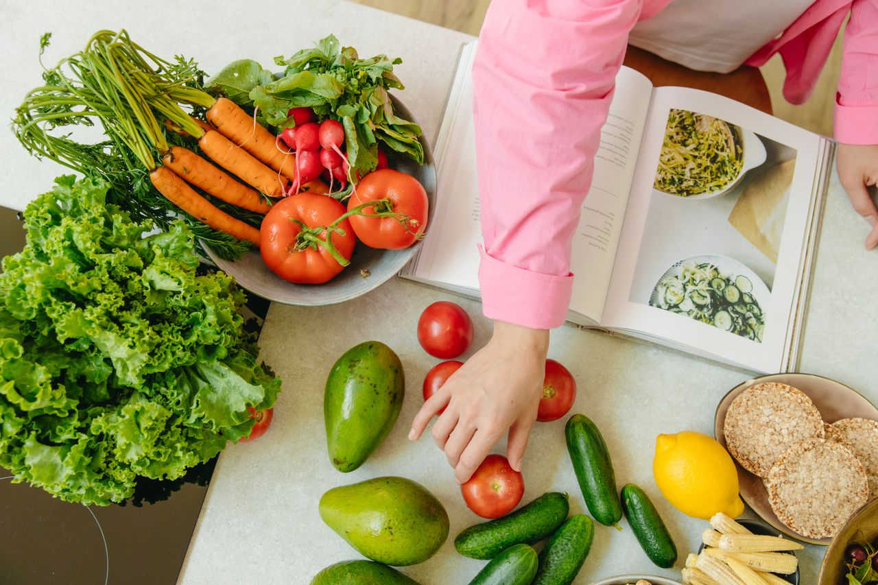
🔬
Nutritional Science Essentials
Macronutrients: carbohydrates (4 cal/g), protein (4 cal/g), fat (9 cal/g)
Micronutrients: vitamins and minerals required in small amounts
Essential amino acids — 9 that your body cannot synthesize
Omega-3 vs omega-6 ratio: modern diet is severely imbalanced (1:20 vs ideal 1:4)
Bioavailability: how well nutrients are absorbed (heme vs non-heme iron)
Together For Health

Slide 4
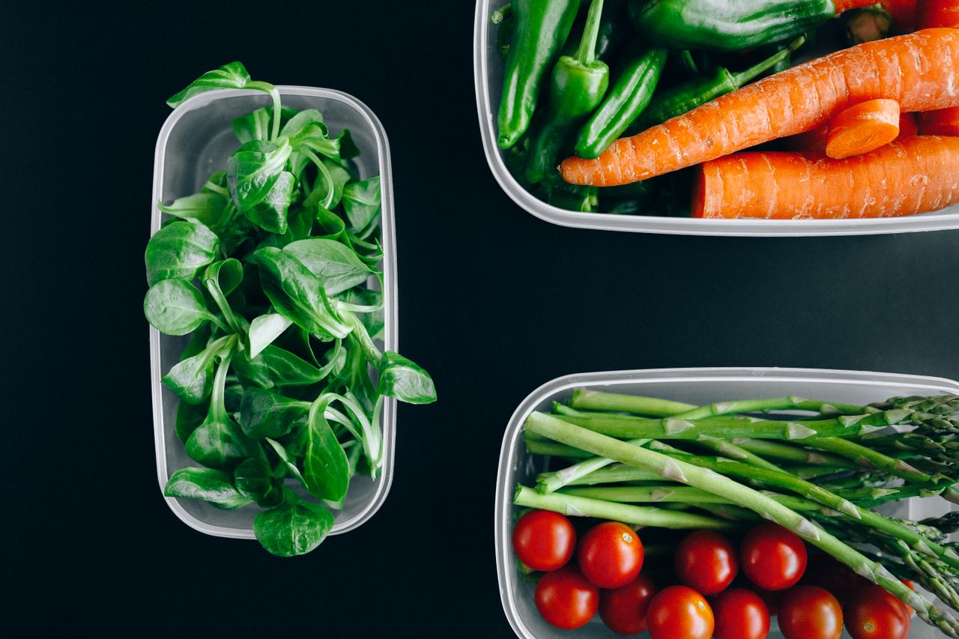
🧠
The Gut-Brain Axis
The gut contains 500 million neurons — the "second brain"
Gut microbiome produces 90% of serotonin and 50% of dopamine
Dysbiosis (unhealthy gut) linked to anxiety, depression, autism
Mediterranean diet consistently shows neuroprotective effects
Antibiotics and ultra-processed foods disrupt microbiome significantly
Together For Health

Slide 5

📊
Evidence-Based Dietary Patterns
Mediterranean diet: best evidence for cardiovascular and mental health
1
Plant-forward eating: reduces chronic disease risk across all categories
2
Intermittent fasting: emerging evidence for metabolic and cognitive benefits
3
Avoid: ultra-processed foods, trans fats, excessive sugar and sodium
4
The anti-inflammatory diet: focus on foods that reduce systemic inflammation
5
Together For Health

Slide 6
⚖️
Weight Is Not the Goal
Health at Every Size (HAES) research shows health behaviors matter more than BMI.
Focusing on eating patterns, movement, and wellbeing — not weight — produces better health outcomes.
Together For Health

Slide 7
KEY TAKEAWAYS
Nutrition science is evolving — stay critical of trends
✓
Diet quality in adolescence predicts adult health outcomes
✓
The most evidence-based approach: whole foods, variety, moderation
✓
Resources
Canada Food Guide: food-guide.canada.ca
The Gut-Brain Axis — PubMed research summaries
Registered Dietitian Consultation: dietitians.ca
Together For Health

